Slide 1
Chapter 8: Apply algorithm to solve complex mathematical functions

Slide 2
Understanding quadratic equation
The quadratic equation is a second degree polynomial equation since it only contains powers of x that are non-negative integers.

Slide 3
Algorithm: SolveQuadraticEquation
Input: Coefficients a, b, c (real numbers)
delta = b^2 - 4ac
If delta > 0:
root1 = (-b + sqrt(delta)) / (2a)
root2 = (-b - sqrt(delta)) / (2a)
If delta = 0:
root = -b / (2a)
If delta < 0:
realPart = -b / (2a)
imaginaryPart = sqrt(abs(delta)) / (2a)
root1 = realPart + imaginaryPart * I
root2 = realPart - imaginaryPart * I
Print root 1,root2
End

Slide 4
Recursive function
Definition:
Recursive function is a function that calls itself during its execution. The Recursive function repeats itself several times, outputting the result at the end of each iteration.
In this section we are going to discuss the following recursive functions:
- Summing a list of numbers;
- Factorial function;
- Fibonacci series function;
- Sorting;
Palindrome.

Slide 5
Summing a list of numbers
To calculate the sum of a list of numbers such as: [1, 3, 5, 7, 9], below is the pseudo code which is an iterative function that computes the sum of a list of numbers.
Deflistsum(numList):
theSum = 0
For i in numList:
theSum = theSum + i
returntheSum
print(listsum([1,3,5,7,9]))

Slide 6
The function uses an accumulator variable (thesum) to compute a running total of all the numbers in the list by starting with 00 and adding each number in the list

Slide 7
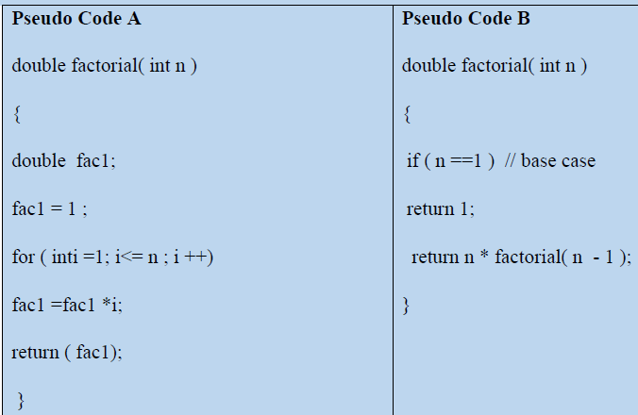
Factorial function

Slide 8
In mathematics, the factorial of a non-negative integer n, denoted by n! is the product of all positive integers less than or equal to n.
Notice that the value of 0! is 1, according to the convention for an empty product.

Slide 9
Cont‘d
The factorial function (symbol: !) means to multiply a series of descending natural numbers.
Examples:
4! = 4 × 3 × 2 × 1 = 24
7! = 7 × 6 × 5 × 4 × 3 × 2 × 1 = 5040
1! = 1

Slide 10
Fibonacci series function
In mathematics, the Fibonacci numbers are integer numbers in the following sequence: 0, 1, 1, 2,3, 5, 8..., this series of integers is called the Fibonacci sequence. Fibonacci sequence is characterized by the fact that every number after the first two is the sum of the two preceding one.
It means that except for the first two terms of the sequence every other term is the sum of the previous two terms.

Slide 11
The pseudo code of Fibonacci function
BEGIN Fibonacci(n):
Initialize an array fib of size n
Set fib[0] = 0, fib[1] = 1
for i from 2 to n-1 do:
fib[i] = fib[i-1] + fib[i-2]
return fib
END

Slide 12
Palindrome function
A palindrome is a word that is spelled the same from both ends.
For example: anna, ifi, isi, and malayalam are palindromes.
The table below gives two basic ways of determining whether a word is a palindrome.

Slide 13
Algorithm to check a number
The algorithm which would get out any amount palindrome numbers on screen.Let take: 300003 310013 320023 330033 340043 350053.
Findings: written algorithm how to check if it is a palindrome number or not.

Slide 14
Here is algorithm for how i check if its palindrome or not:
BEGIN
int n, num, dig, rev = 0
PRINT ”Insert number”
READ num
n = num
while (num != 0)
dig = num % 10
rev = (rev * 10) + dig
num = num / 10
}
if (n == rev)
PRINT ”This is palindrome”, rev
Else
Print “this is not palindrome”
End
To check a number

Slide 15
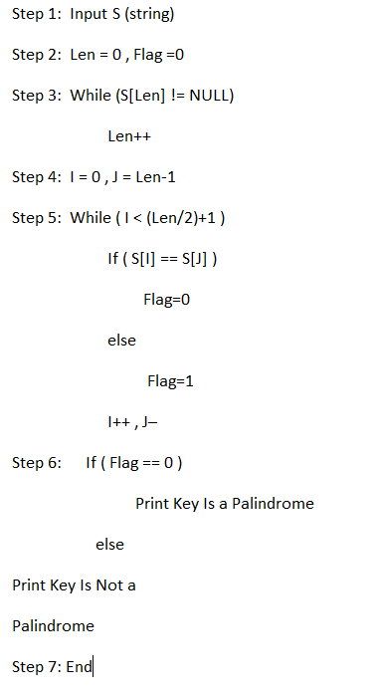
To check a String

Slide 16
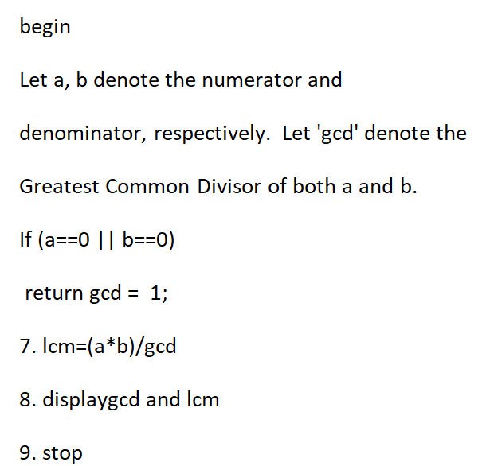
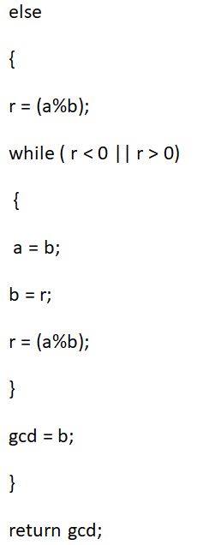
Euclid's GCD(Greatest common denominator)

Slide 17

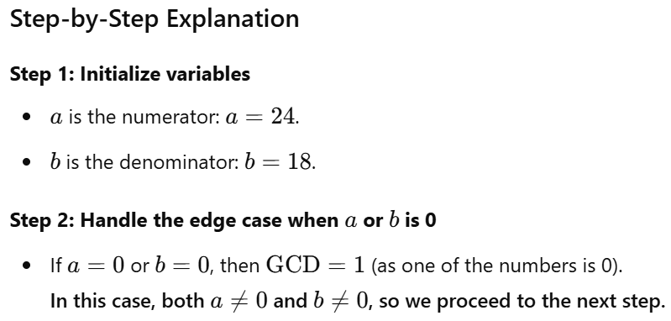

Slide 18
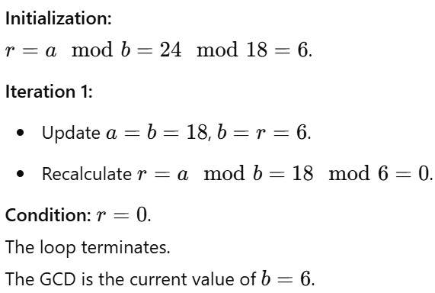
Step 3: Compute the GCD using the Euclidean algorithm

Slide 19
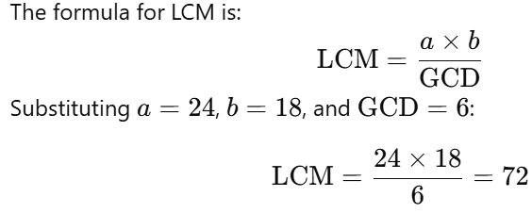
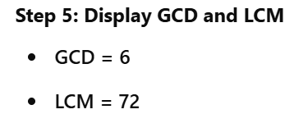
Step 4: Compute the LCM

Slide 20
Apply the GCD algorithm to calculate
a=56 and b=15
The GCM and LCM of

Slide 21
End

